Slide 1

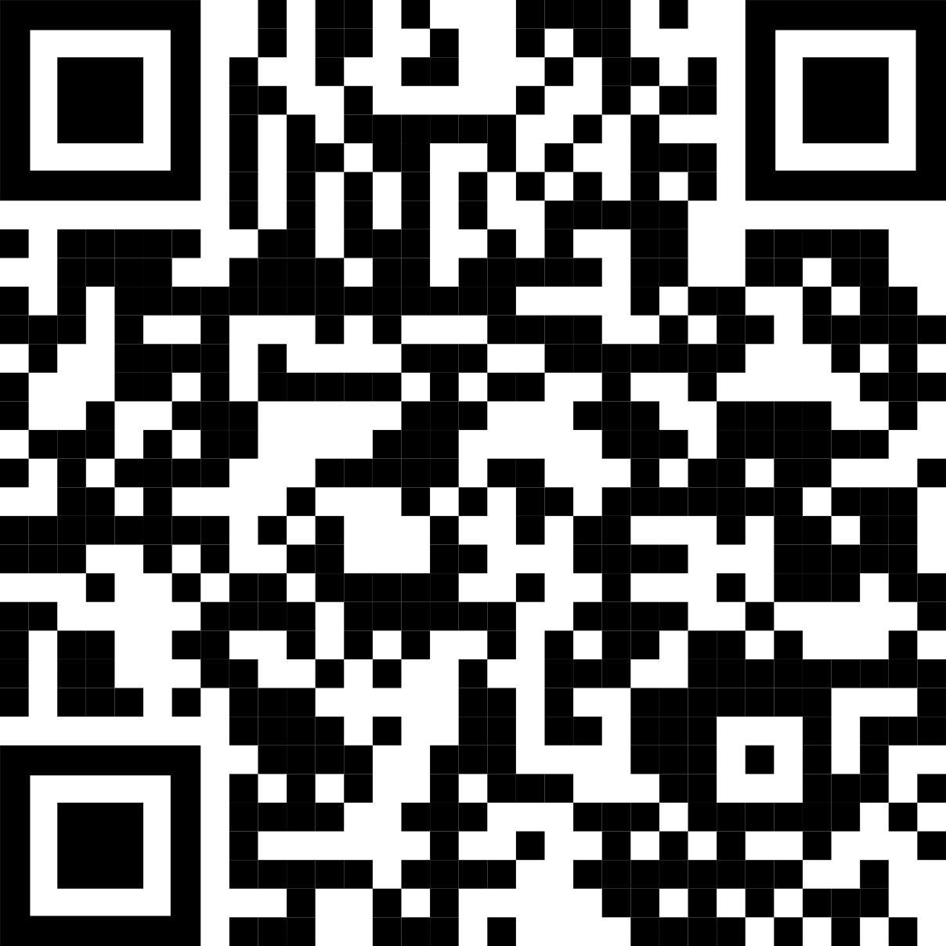
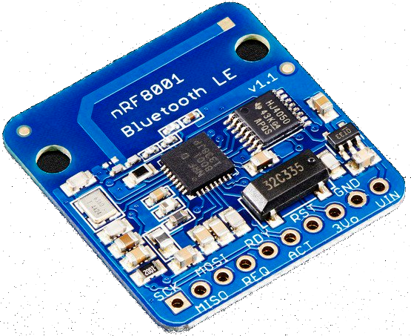
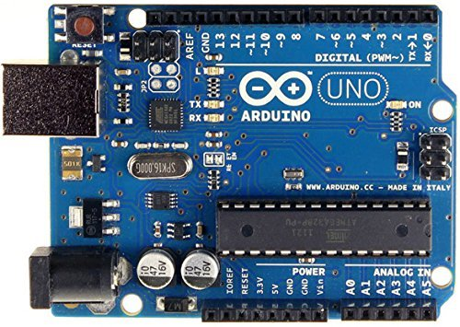
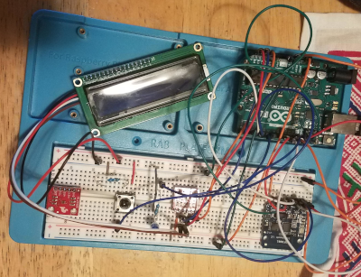

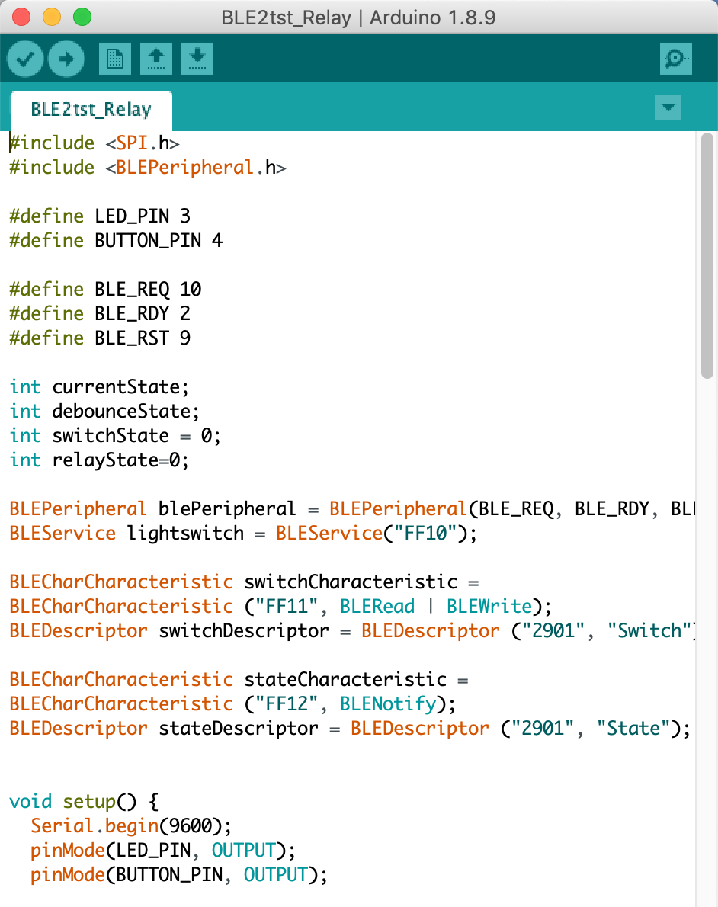
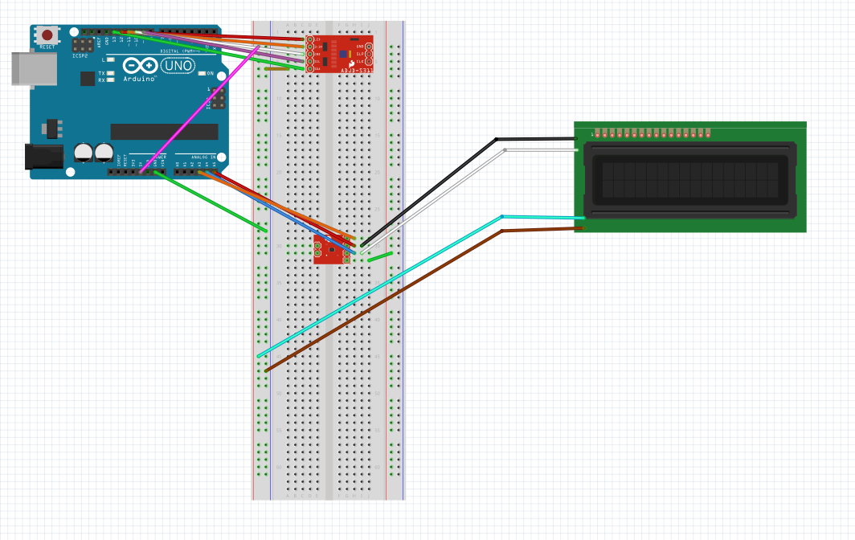
Internet of Things: R&D With Embedded Systems
Matthew Aylor, Zachary Daher, Tami Farber, Clinton Schultz, and Dr. Samuel Sungmin Cho
R&D
We experimented with different devices to understand how they communicate using embedded systems, like Arduino, for controlling simple devices like switches and prompting sensors to provide data.
BLE
Next we integrated a Bluetooth Low Energy (BLE) chip as a means of communicating between the Arduino and a mobile device.
INTRODUCTION
As IoT (Internet of Things) technology continues to gain popularity in our modern world, we should try to understand how it works and how it can be implemented to solve important problems across many disciplines.
RESULTS
Control light switch using BLE (Bluetooth Light Emission) technology with Android/IOS applications.
Obtain and display temperature data on LCD screen using temperature sensor and I2C (Inter-Integrated Circuit).
FUTURE RESEARCH
Analog security switch/lock
Digital encryption, password protection
Increasing sensor array to include motion, light, and proximity sensing,
Cloud-based interface for remote access
Database of sensor readings
ACKNOWLEDGEMENTS
Funding for this research was provided by the Northern Kentucky University Center for Integrative Natural Science and Mathematics (CINSAM) and Project FORCE NSF DUE STEP Award #0969280 through CINSAM's UR-STEM program.
Take a picture to download poster
Wireless Communication
Adding another layer of control to our system, we programmed the Arduino to communicate with an Android device via Bluetooth using an app installed on the mobile device called Light Blue. From there our phones could read information from the switches and sensors as well as control the switches remotely.
Conclusion
We have explored several options of what the technologies of embedded devices, wireless communication, and I2C cards can do when combined, but there are limitless possibilities. We have plans to explore more and find a new use for these systems to utilize the connectedness the Internet of Things makes possible, to simplify tasks or explore useful data readings.
I²C Bus
We experimented further with multiple sensors in an array by wiring the Arduino to an I²C (Inter-Integrated Circuit) device, The I²C bus allows the data sent by these devices to be interpreted easily. To read the output, we integrated an LCD screen attached to an I²C bus, then used C to code for readings and display.

